Slide 1
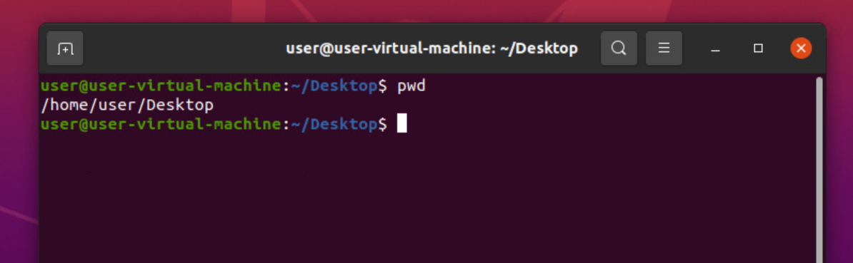
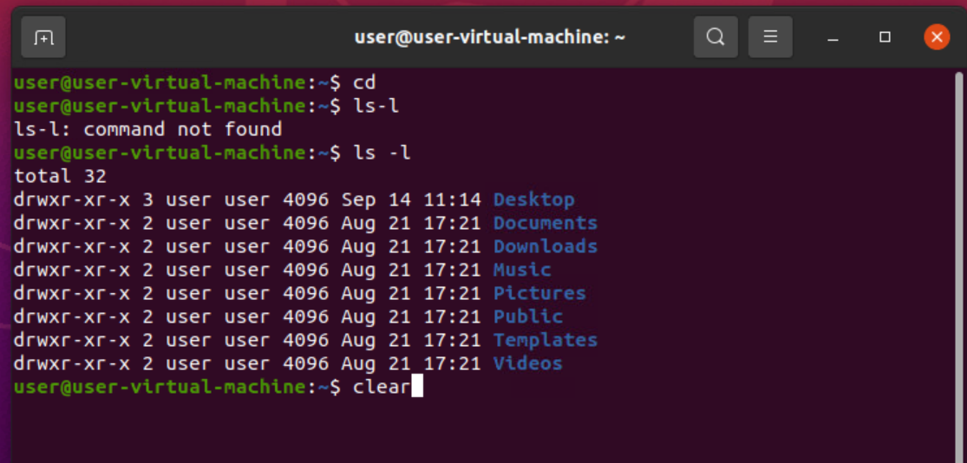
LINUX COMMANDS
1) $pwd :- used to show the present working directory
2) $clear :- used to clear the Terminal Screen

Slide 2
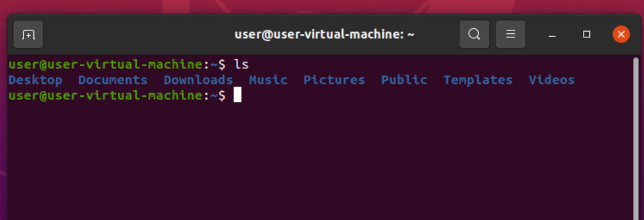
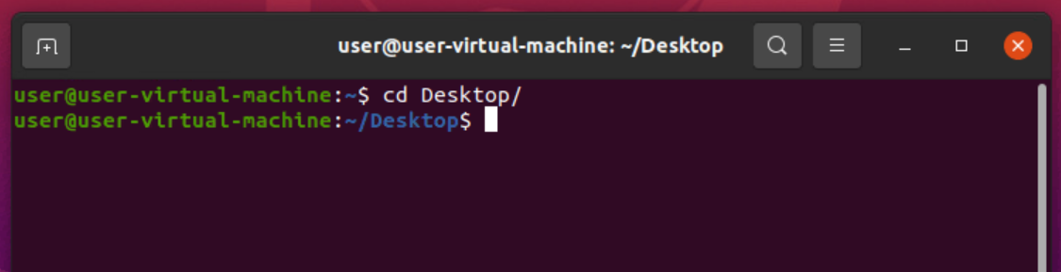
3) $ls :-Lists all the folders present in working directory in Dictionary order
4) $cd :- Used to change the directory

Slide 3
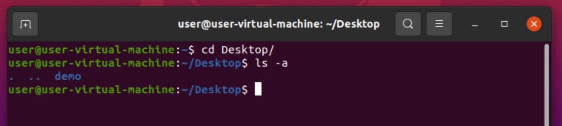
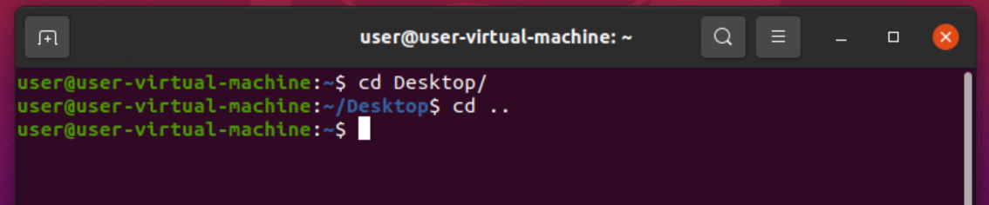
5) $ls –a :- It shows all folders including hidden folders in an dictionary order
6) $cd .. & cd :-used to move to the backward directory

Slide 4
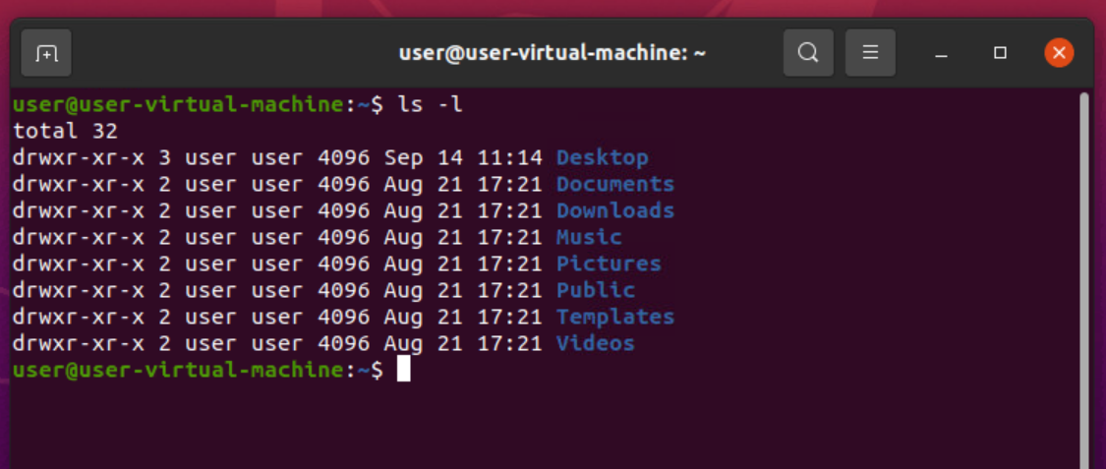
7) ls –l :- Shows all folders in detailed view

Slide 5
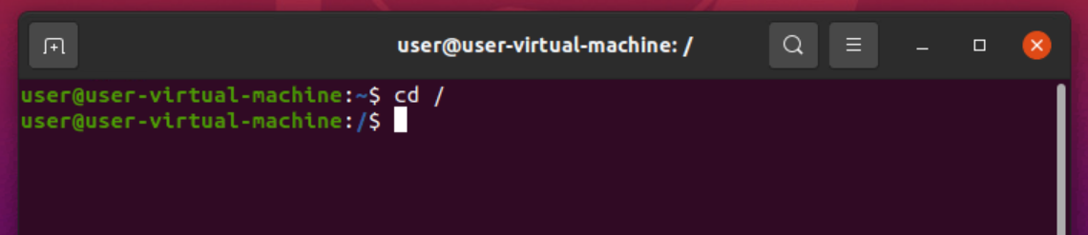
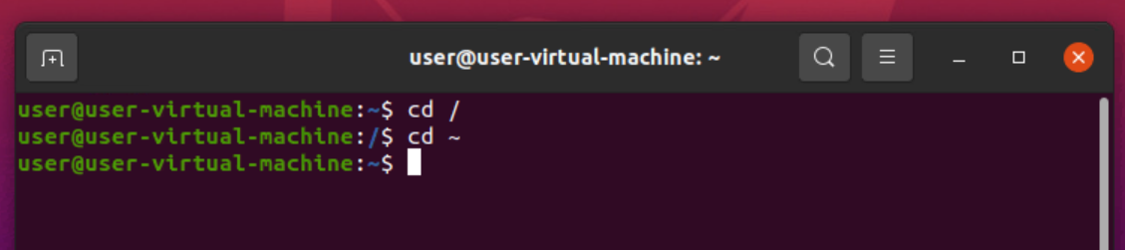
8) cd / :- Its used for moving to root directory.
9) cd ~ :- Its used for moving to Home directory

Slide 6
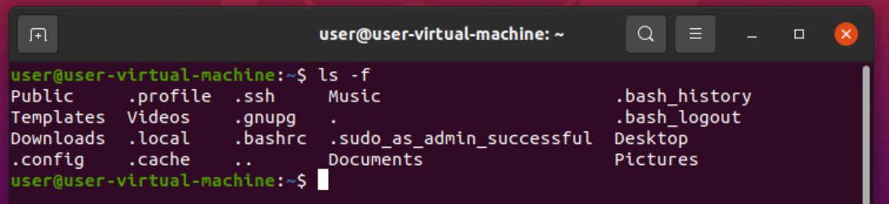
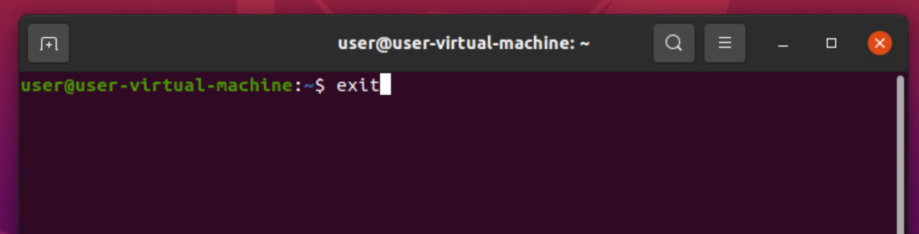
10) ls –f :- Shows all folders without format.
11) $exit :- used to exit the terminal.

Slide 7
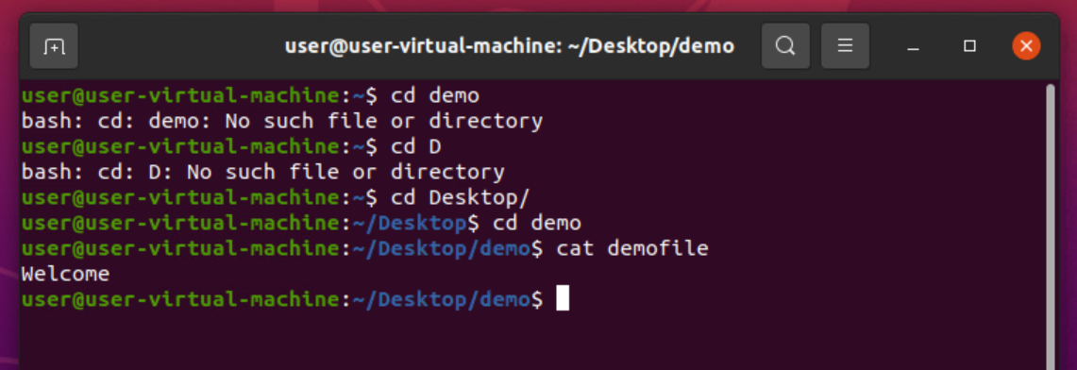
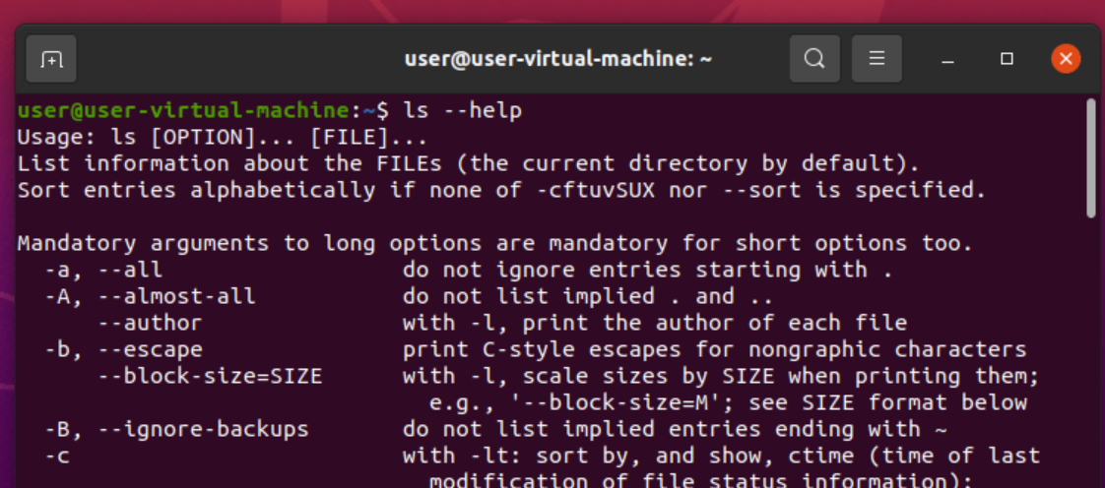
12) cat filename :- Its used to show the content in file.
13) ls –help :- used for help

Slide 8
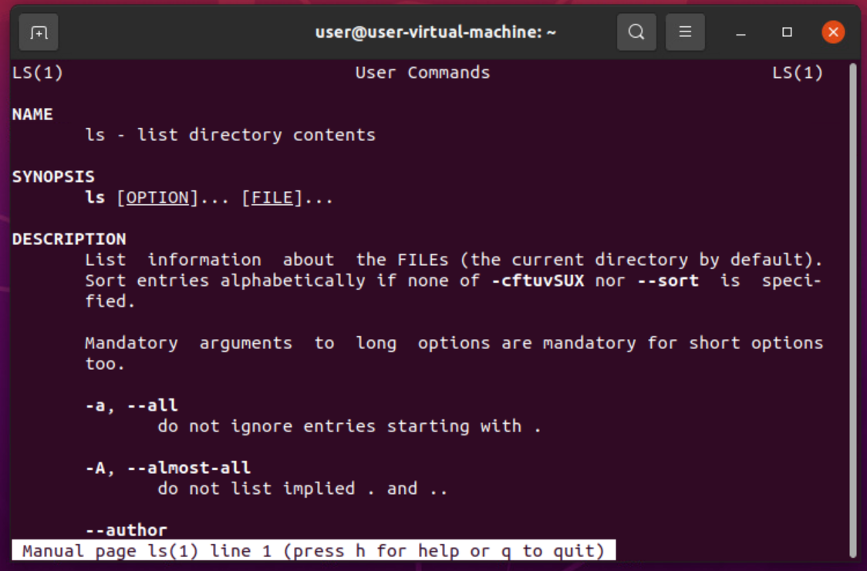
14) $man ls :- used to show the manual page of ls.
Shift + G -> to reach end of page
Shift + g -> to reach start of page
q-> quit h-> help

Slide 9
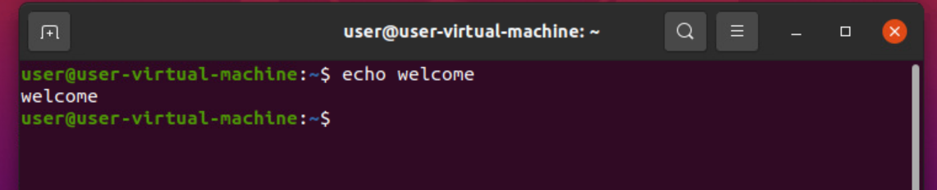
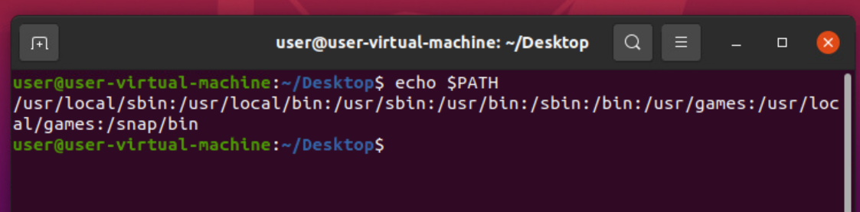
15) $echo :- used to print whatever present after echo
16) $echo $PATH :- used to show the path.

Slide 10
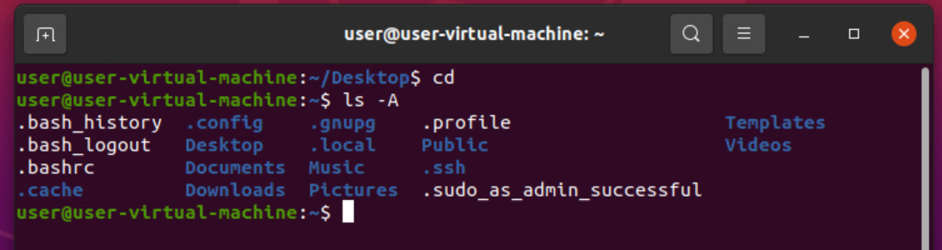
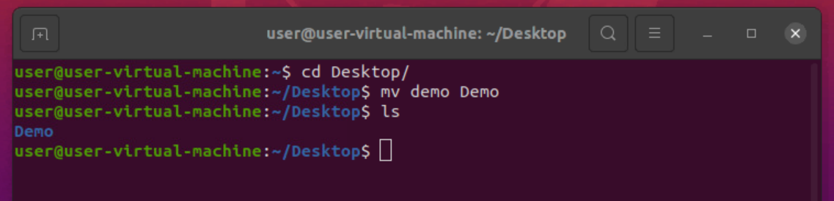
17) ls –A :- Used to show all files and folders present in the directory.
18) $ mv filename updatename :- used to change the file name.

Slide 11
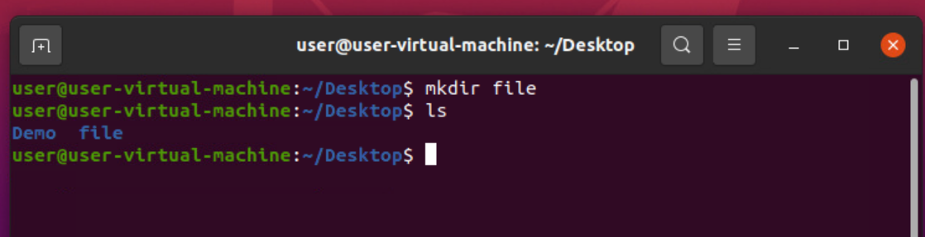
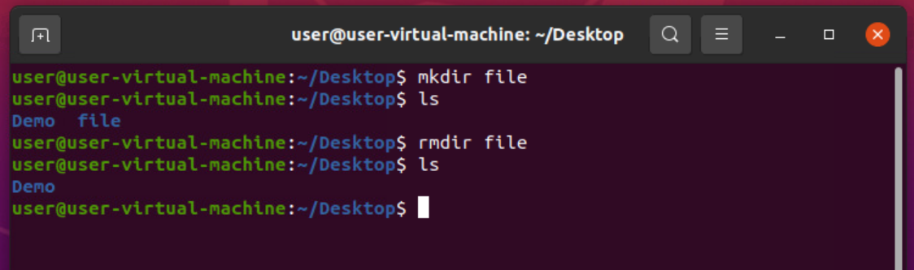
19) $mkdir filename :- used to create file using terminal.
20) $rmdir filename :- used to delete the file using terminal.

Slide 12
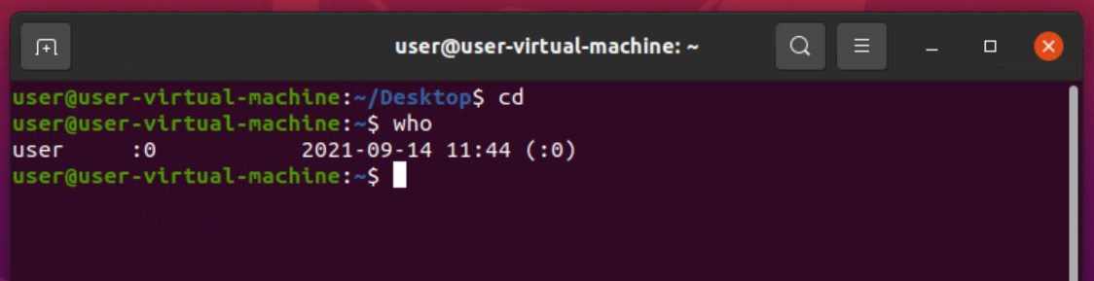
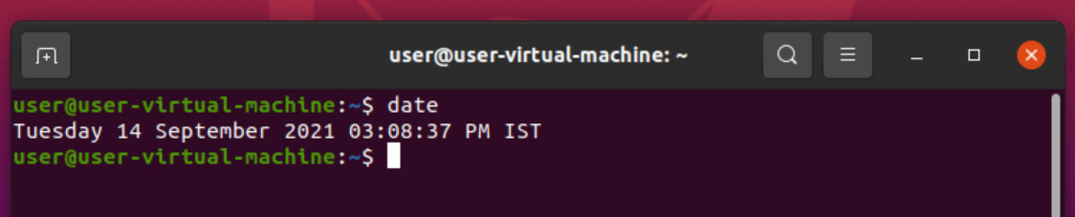
21) $who :- its gives the users and session.
22) $date :- used to show the date and time.

Slide 13
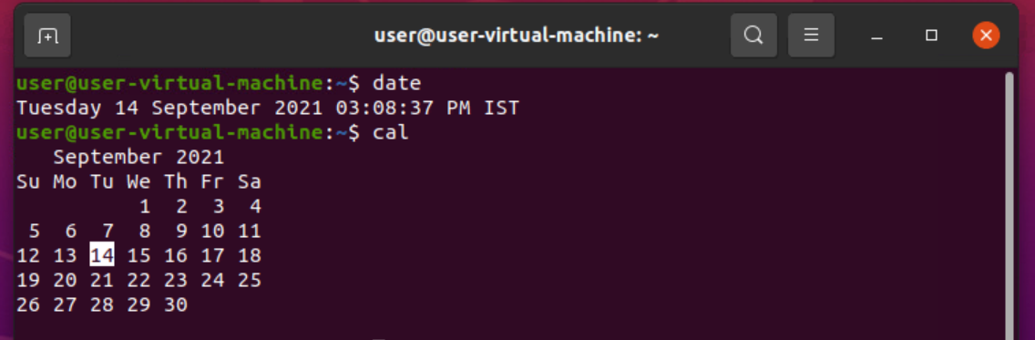
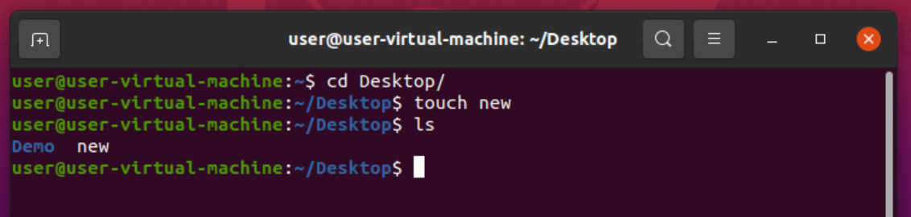
23) cal :- Its shows the current date in calendar.
24) touch filename :- used to create a textfile.

Slide 14
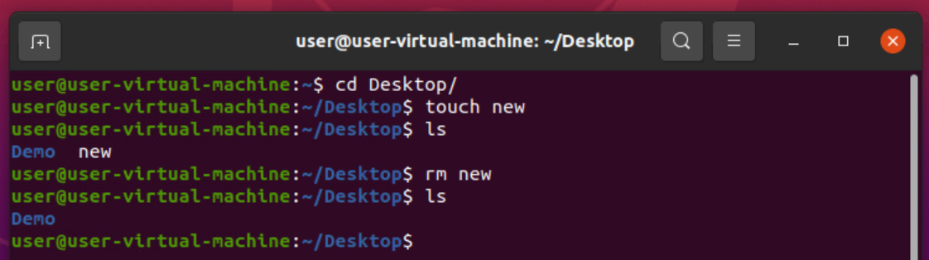
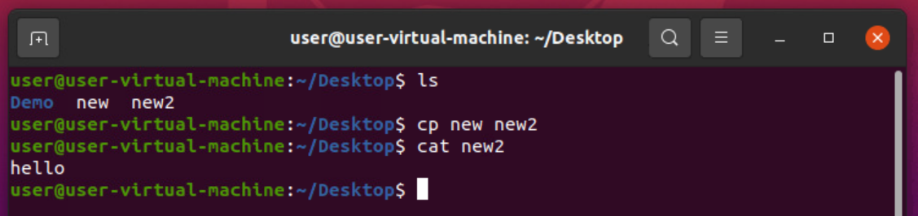
25) $rm filename :- used to remove text file.
26) $cp source destination :- used to copy from one file to another file.

Slide 15
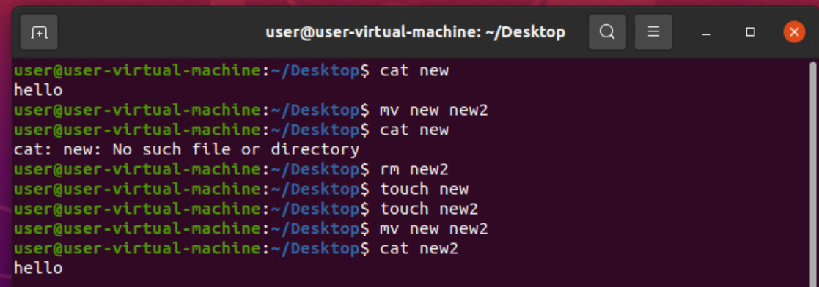
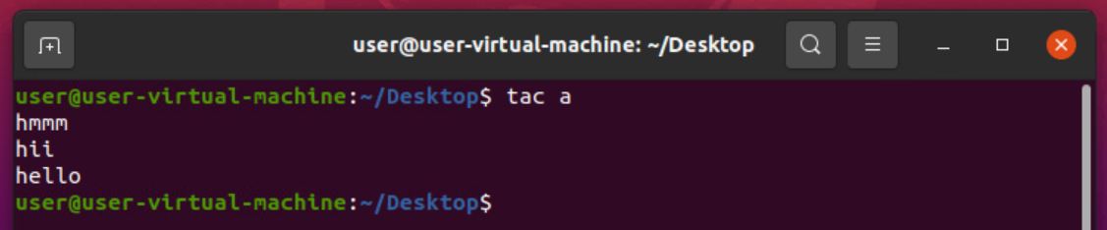
27) $mv source destination :- used to cut the content in file and stored into destination.
28) $tac a :- Used to show data in reverse order.

Slide 16
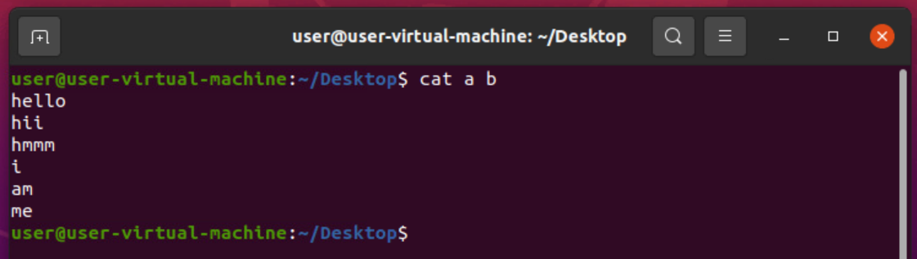
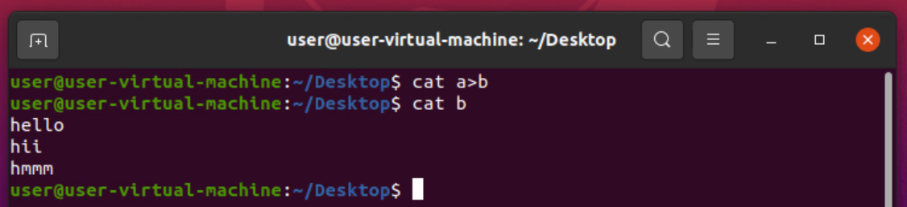
29) $cat a b :- Displays all data present in a,b and c.
30) $cat a>b :-

Slide 17
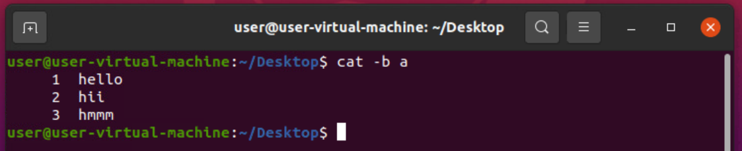
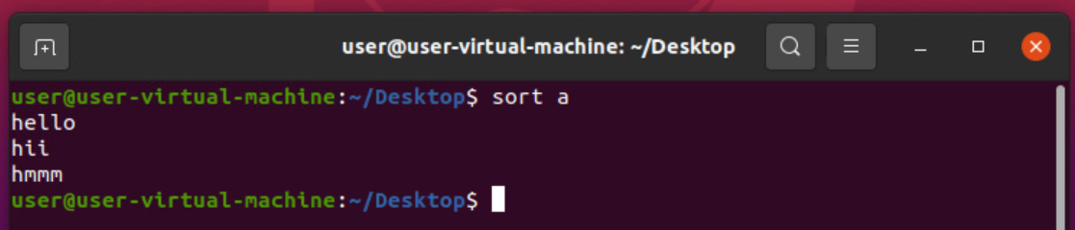
31) cat –b filename :- used to display the line numbers in file.
32) sort a :- shows the data in alphabetical order.

Slide 18
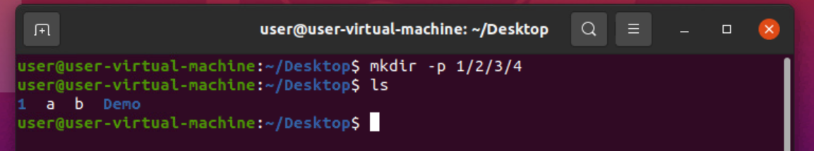
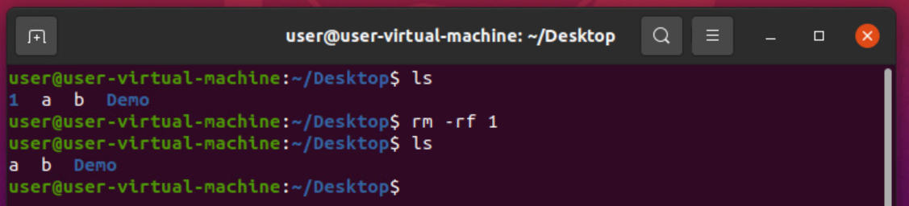
33) mkdir –p a/b/c/d/e :- Creating files inside file and soon.
34) rm –rf a :- Delete all the files inside folder a and can not be recovered.

Slide 19
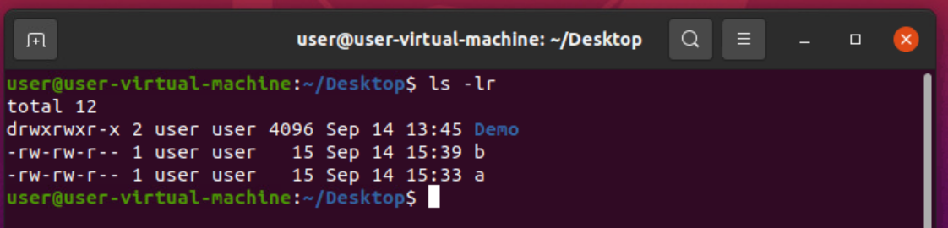
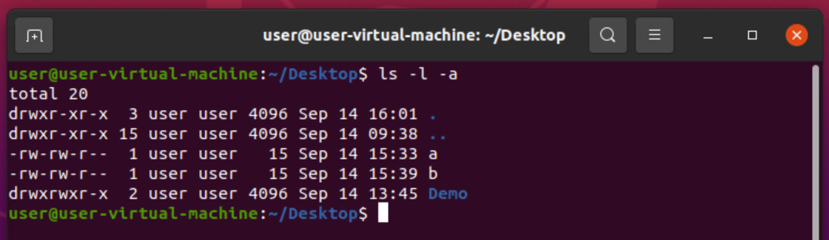
35) ls –lr :- Shows in a recursive way.
36) ls –l –a :- Show all the files.

Slide 20
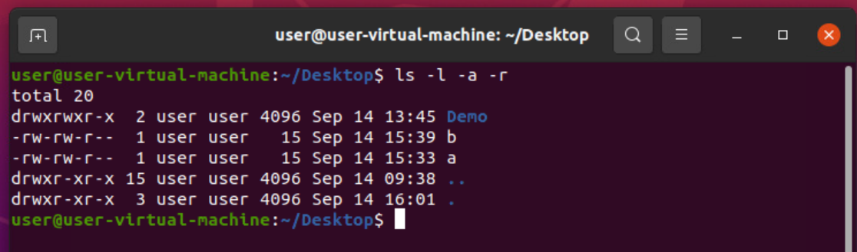
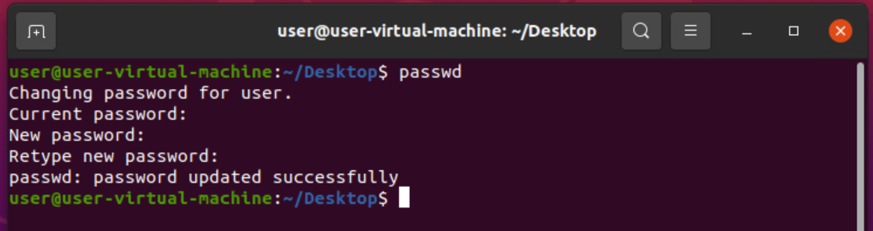
37) $ls –l –a –r (or) ls –lar :- Shows all the files in recursive way.
38) $passwd :- used to change the password.

Slide 21
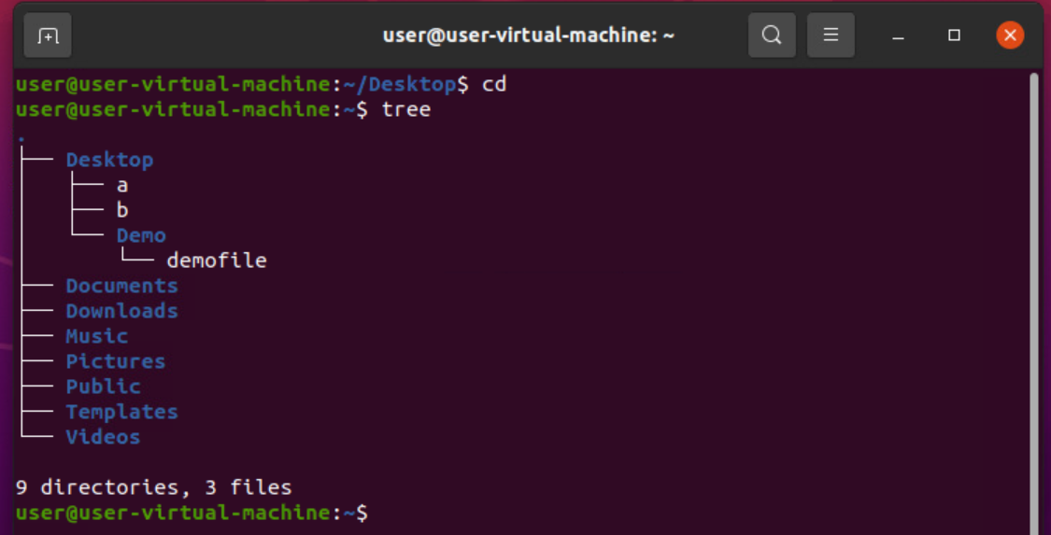
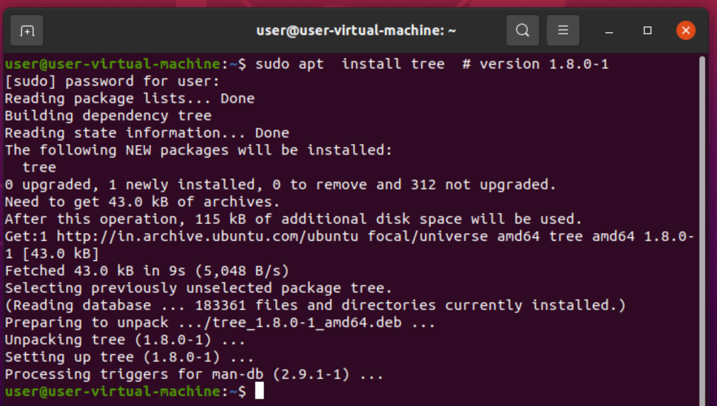
39) $tree :- It lists all the files in an hierarchy way.
40)sudo apt :- used to install any software and applications.

Slide 22
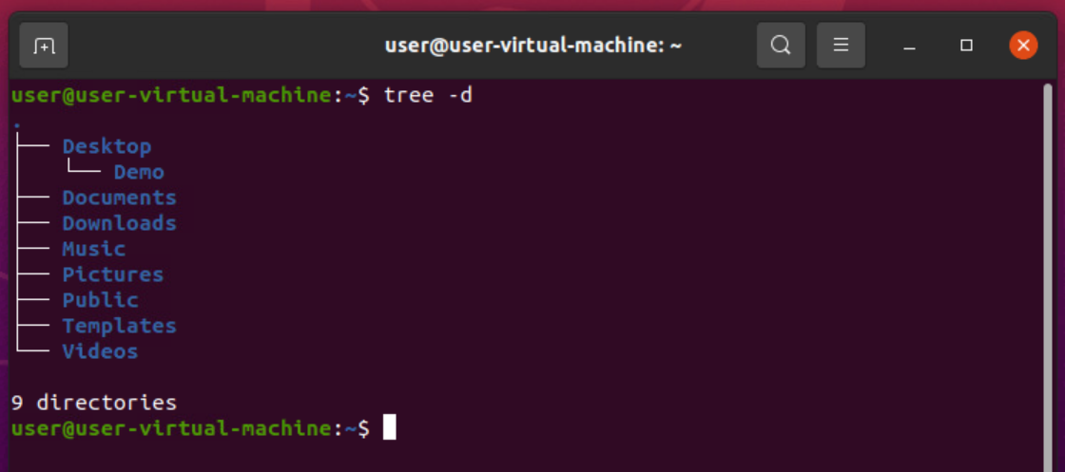
41) ctr + c :- Used to terminate process.
42) tree –d :- Used to show only directory's.

Slide 23
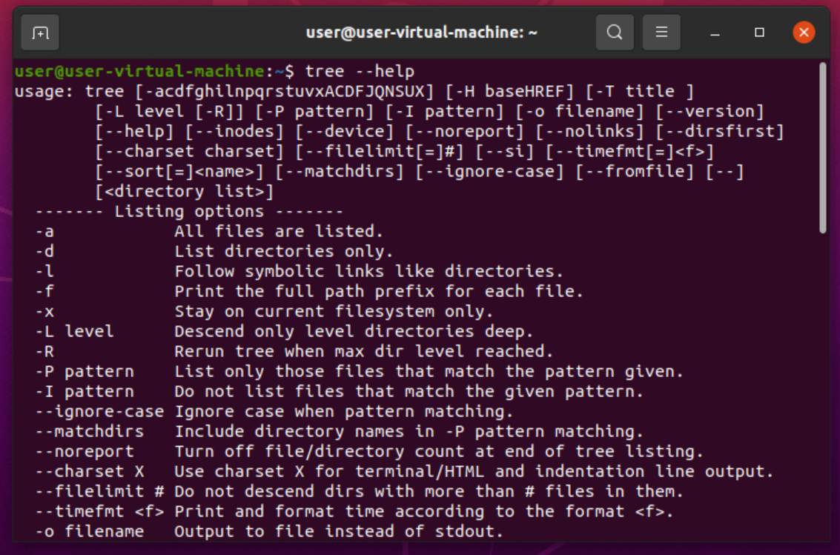
43) tree - -help :- Show all possible ways.

Slide 24
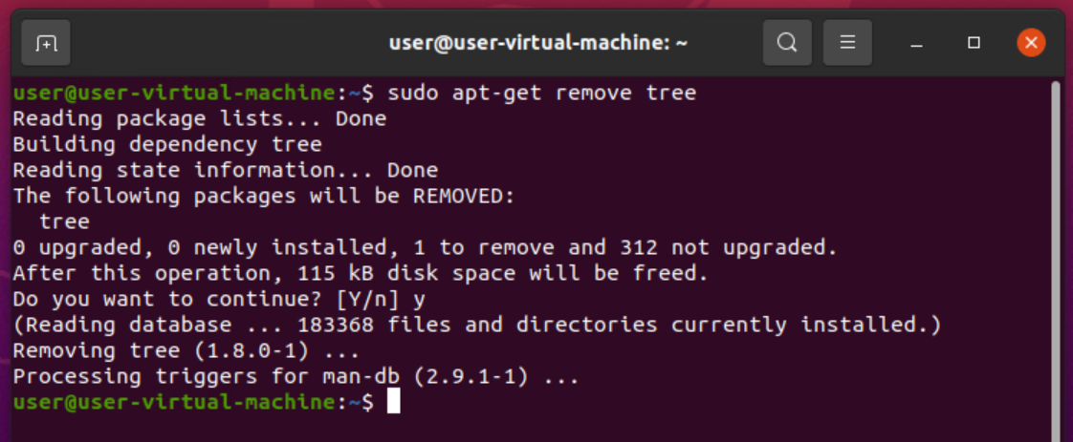
44) sudo apt-get update :-Used to download the software's.
45) sudo apt-get upgrade :-Used to install the software.
46) sudo apt-get update & upgrade :- Used for both download and install.
47) sudo apt-get remove software name :- Used to uninstall software's.

